Slide 1

OmniVRse
VR
OMNI SE
THE ONLY HAPTIC GLOVE YOU’LL EVER NEED
Telephone
Address
July 2024
9910977193
VIT Chennai , Kelambakkam - Chennai, Tamil Nadu

Slide 2

ABOUT US
GET TO KNOW US BETTER
At Omni, we believe in the transformative power of innovative technology, seamless communication, and cutting-edge functionality. Our mission is simple: to empower individuals and organizations with advanced multi-purpose gloves that not only enhance interaction but also drive tangible improvements in communication coordination and productivity.
We Believe technology is part of human, and use them to evolve together as a species

Slide 3

UNIQUE SELLING POINT
WHAT MAKES US DIFFERENT
ONE SIZE FITS ALL
The amount of investment , space and products to be bought to fully leverage the advantages of haptic controlled devices now and going forward in this fast advancing world is immense. Our mission is to fix this and make haptics affordable
AFFORDABILITY AND COMMERCIALIZATION
OmniVRse makes gloves that fit all your haptic needs, with just one product! Thus reducing on the cost of investment , maintenance , learning curve and storage space whilst improving the ease-of use for the user.

Slide 4

PROBLEMS
WE WILL SOLVE THE PROBLEMS
01
Expensive Products
VR and Haptic based products/gadgets are highly expensive as a product, on top of which these products incur shipping charges due to lack of availability across different regions including India. Thus , not able to tap a huge potential market.
03
Lack of sensitivity in devices
Majority of the currently existing haptics-based devices in the market have low sensitivity and harder to use controls , producing a negative and bad user experience across different domains and use cases in daily life like gaming, smart controls , sign language intrepretation etc...
02
No Generalized Product
Haptics Products in general are developed for niche or specialized use-cases, thus requiring users being forced to buy multiple products to handle even similar use-cases but on different technology bases.

Slide 5


SOLUTIONS
01
Affordable Haptic Gloves
SOLUTIONS OF THE PROBLEMS
Gloves offer an immersive, tactile experience at a fraction of the cost. Designed for everyday use, they enhance real-world applications, making advanced technology accessible and driving growth in various industries.
02
All-in-One Digital control solution
A comprehensive system integrating all digital control needs into one platform, enhancing efficiency, streamlining operations, and driving growth across various industries with user-friendly, cutting-edge technology.
03
High Sensitivity leveraged by physical sensors
Our technology utilizes advanced physical sensors to achieve high sensitivity, providing precise, real-time data for enhanced performance and accuracy in various applications, driving innovation and efficiency.
Thynk Unlimited

Slide 6
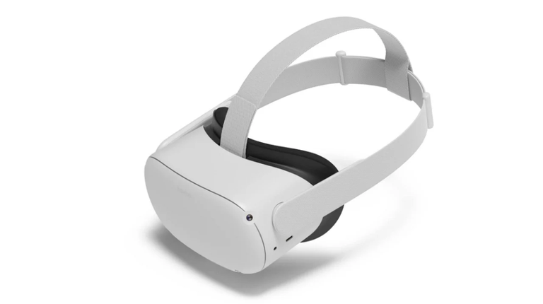
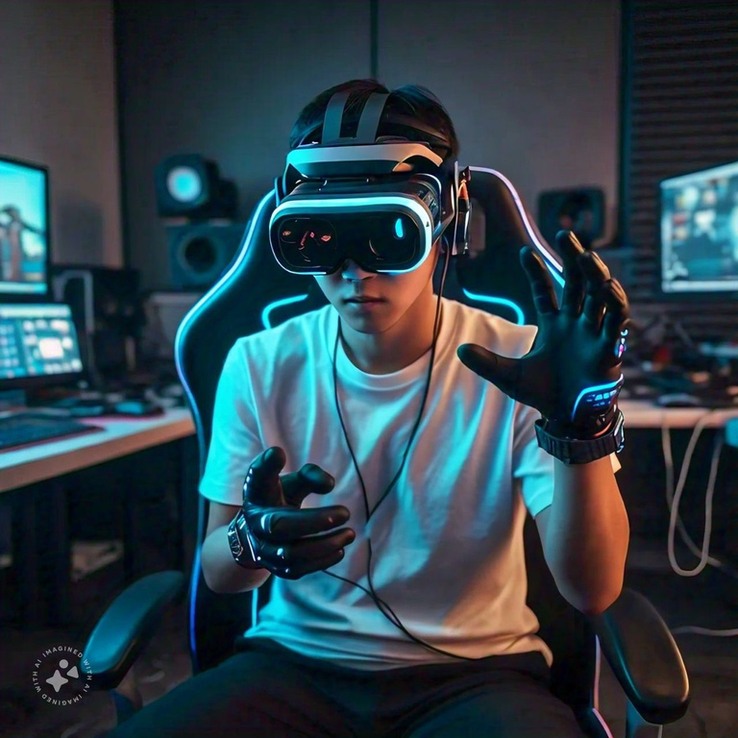
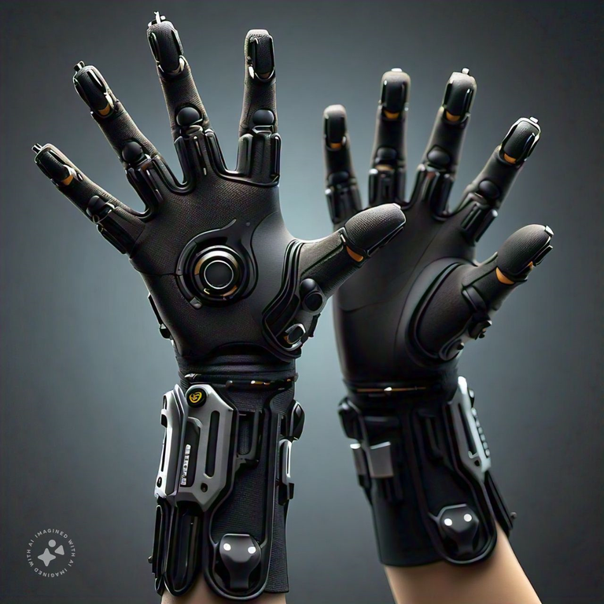
OUR INDUSTRIES
WHAT WE COULD DO
Gaming and Entertainment
Enhancing Productivity with VR Gloves
Bridging Communication
One of the most significant areas where AR and VR are used. Companies like Meta (formerly Facebook), Sony, and HTC are major players.
VR Gloves translate gestures to text and speech, enabling seamless communication for deaf individuals, military operations, and bike riding, enhancing safety and coordination across various environments and situations.
VR Gloves Beyond Virtual Worlds
Gesture-based computing, seamless device interaction, and intuitive 3D manipulation boost efficiency in diverse work environments.

Slide 7

MAJOR MARKET CONTRIBUTORS
Oculus (Meta Platforms, Inc.)
The company's VR products, including the Oculus Rift and Oculus Quest, have significantly contributed to the widespread adoption of VR in the consumer and gaming sectors.
Sony Interactive Entertainment LLC
The PlayStation VR headset and associated VR content have helped Sony establish a strong presence in the consumer VR space.
Apple
Apple vision pro max’s advanced technology and seamless integration attract both consumers and developers, driving market growth, fostering innovation, and solidifying Apple's dominance in the rapidly expanding VR market.
Our product makes the VR dream more accessible and useful for everyday activities, enhancing real-world applications and driving the growth of company’s market value.

Slide 8

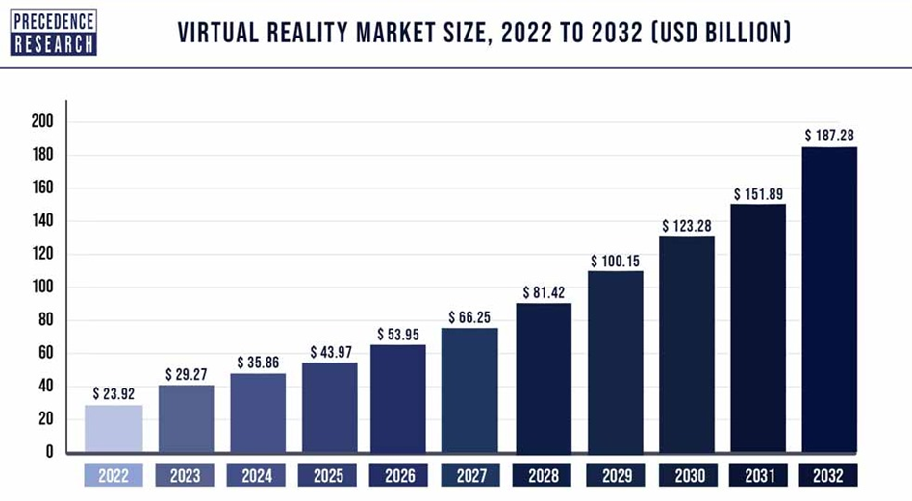
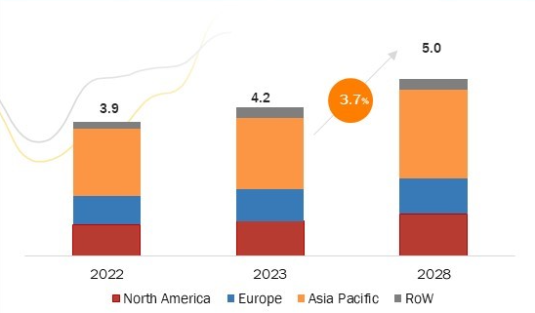
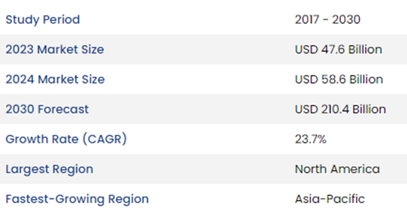
INDUSTRIAL STATISTICS
Thynk Unlimited
VR Market Growth
Haptic Technology Market Growth
Statistics shows a steady upward trend with a CAGR of 3.7%, indicating an accelerating growth throughout the decade (2022 - 2032). This predicted growth depicts the upcoming technological advancements, and the expanding scope of VR applications.

Slide 9
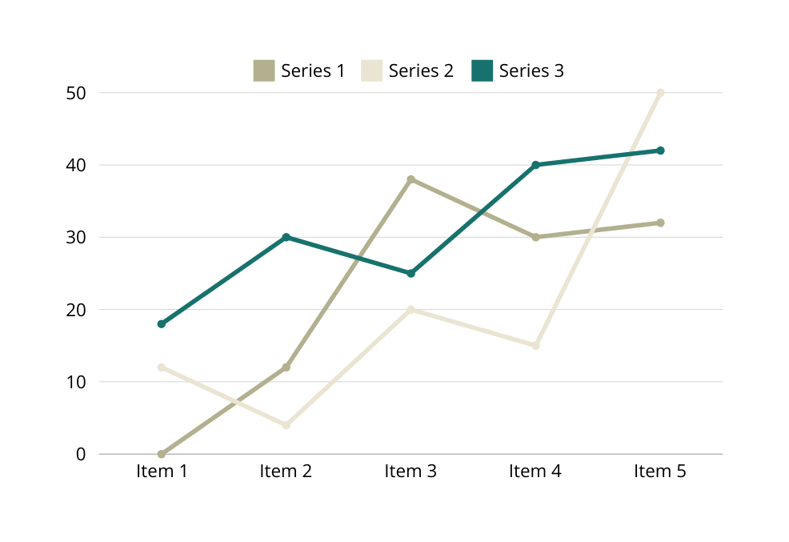

STATISTIC
CLIENT’S SATISFACTION
At the heart of our success lies the unwavering satisfaction of our clients. We take pride in fostering lasting partnerships, consistently exceeding expectations, and delivering results that not only meet but surpass the unique objectives of each client we serve.
From brand positioning and messaging to visual identity, we guide you through every step.
Navigate the path to increased sales with our insightful report and offering a strategic roadmap.
Amplify your revenue streams, engage customers, and unlock the full potential of your business.

Slide 10

COST EFFICIENCY
A COMPARISON
$1500+ | OmniVRse
$5000+ | HaptX Gloves
MORE COST SAVING
70%
$3,000 | VRgluv
$4,500 | SenseGlove Nova

Slide 11
OUR TEAM
Ashish Ram J A
Achyut Narayan H
Karneeshkar Velmurugan

Slide 12
THANK YOU
FOR YOUR NICE ATTENTION

